Slide 1
Digital Democracy: Large Language Models for Transparency & Accountability
Candidate: 710071555

Slide 2
Problem
If we don’t know how our local representatives vote, how can we hold them to account when they don’t act in our interest?
The Information Gap

Slide 3
Structure
Transparency & Accountability
Trends & Findings
Methodology
Conclusion

Slide 4
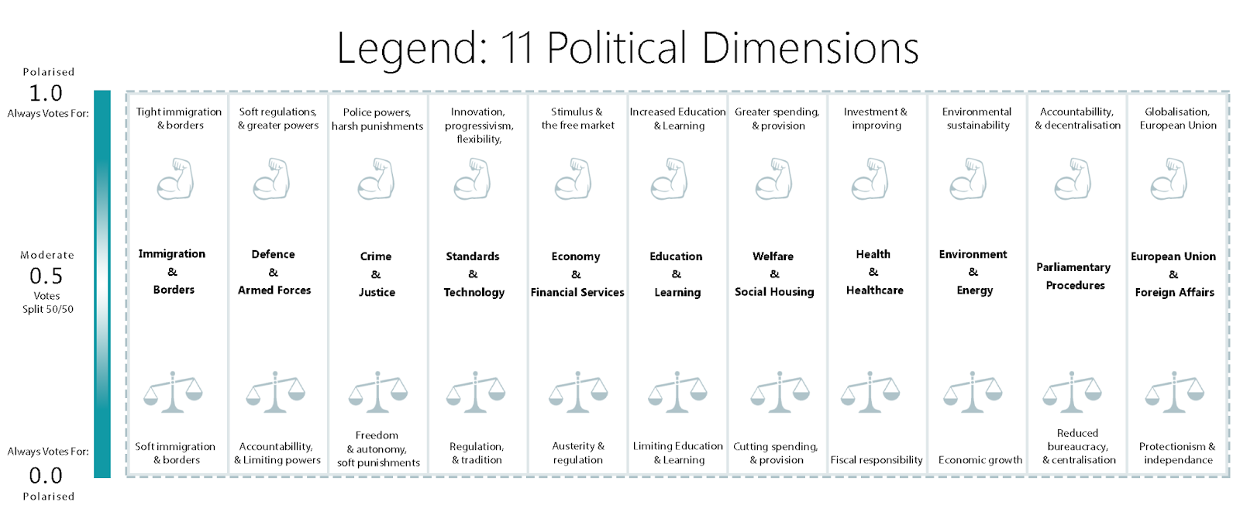
Transparency & Accountability

Slide 5
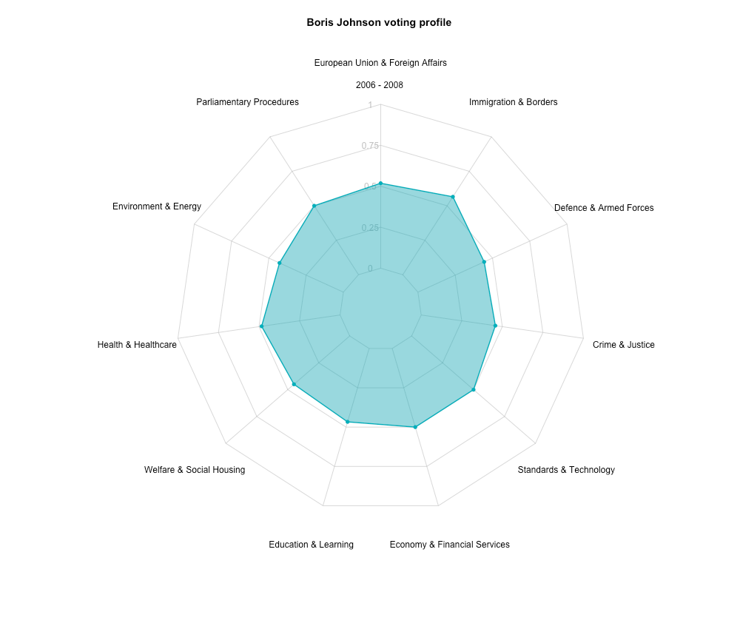
Transparency & Accountability

Slide 6
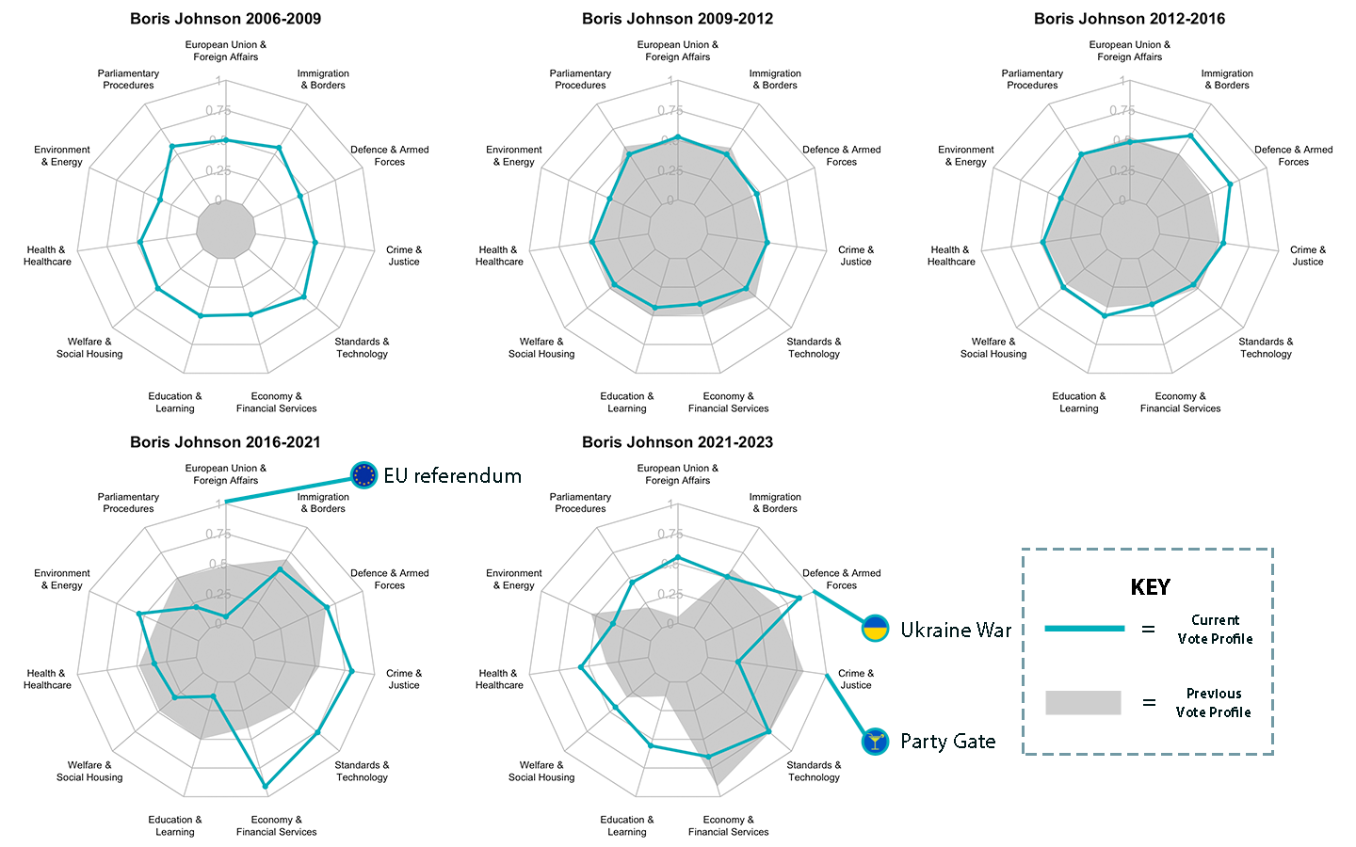

Slide 7

Transparency & Accountability

Slide 8
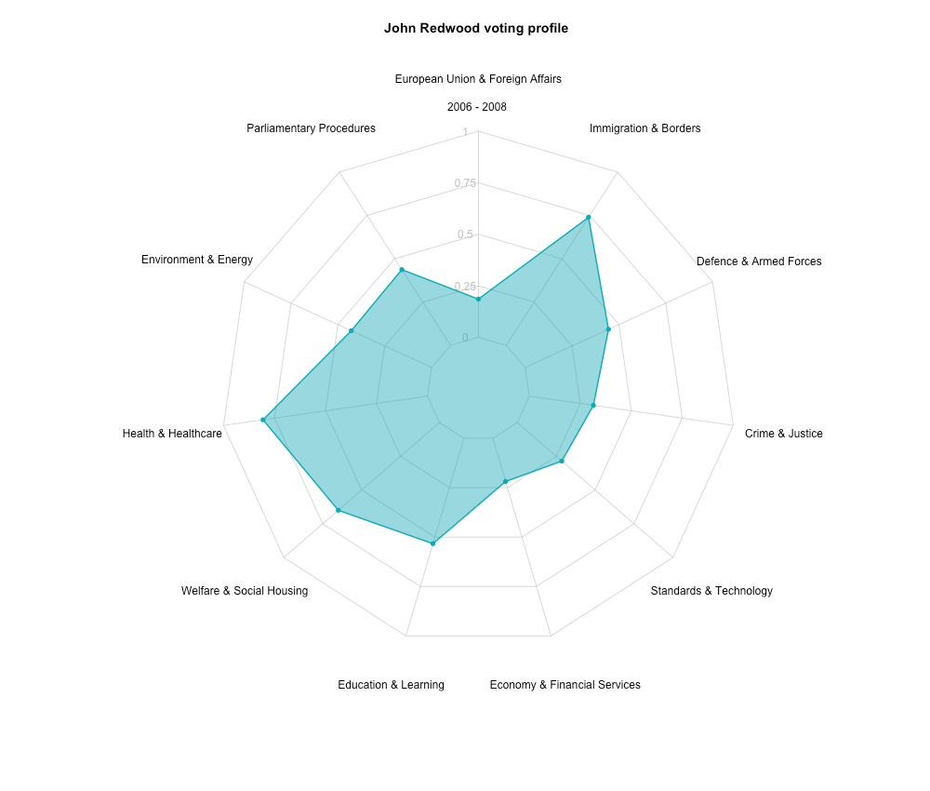
Transparency & Accountability

Slide 9
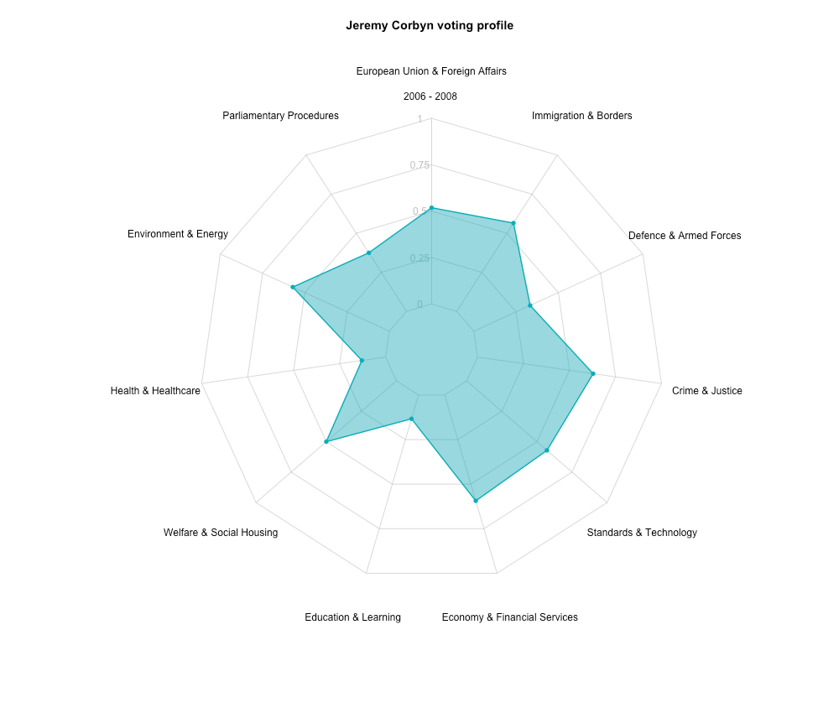
Transparency & Accountability

Slide 10
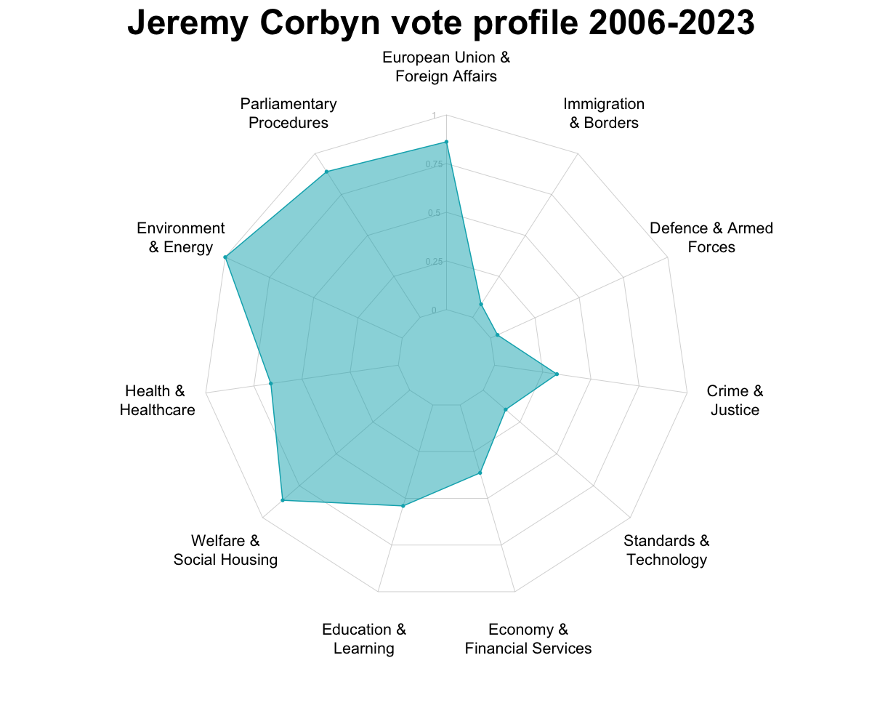
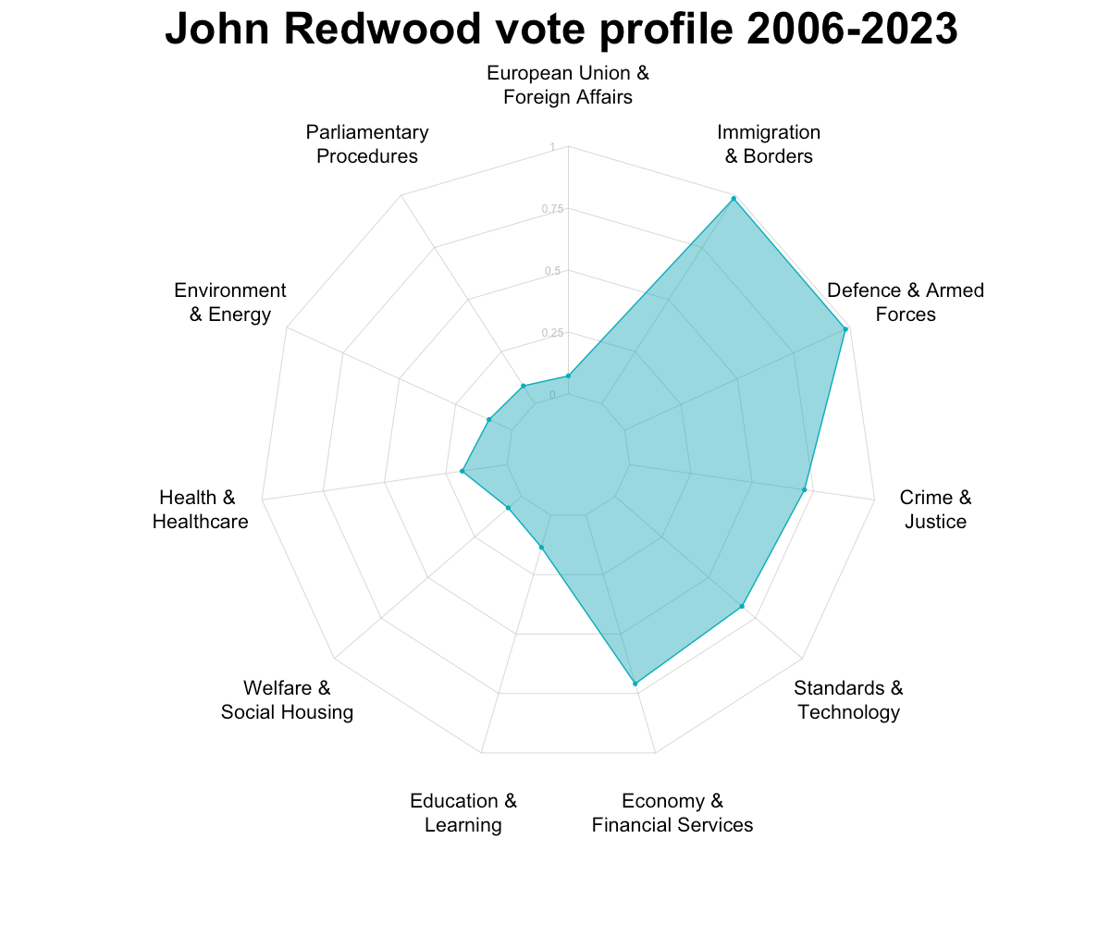
(Jeremy Corbyn - Labour Vs. John Redwood – Conservative)
Transparency & Accountability

Slide 11
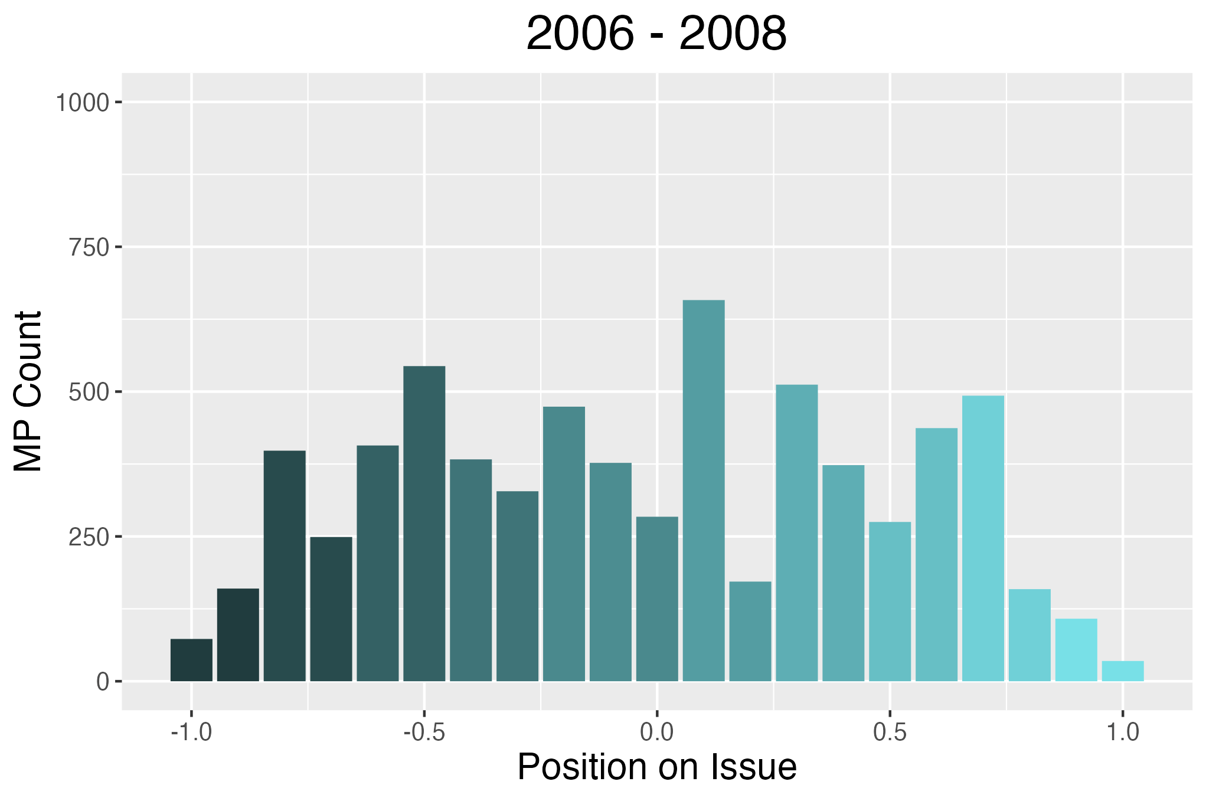
Trends

Slide 12
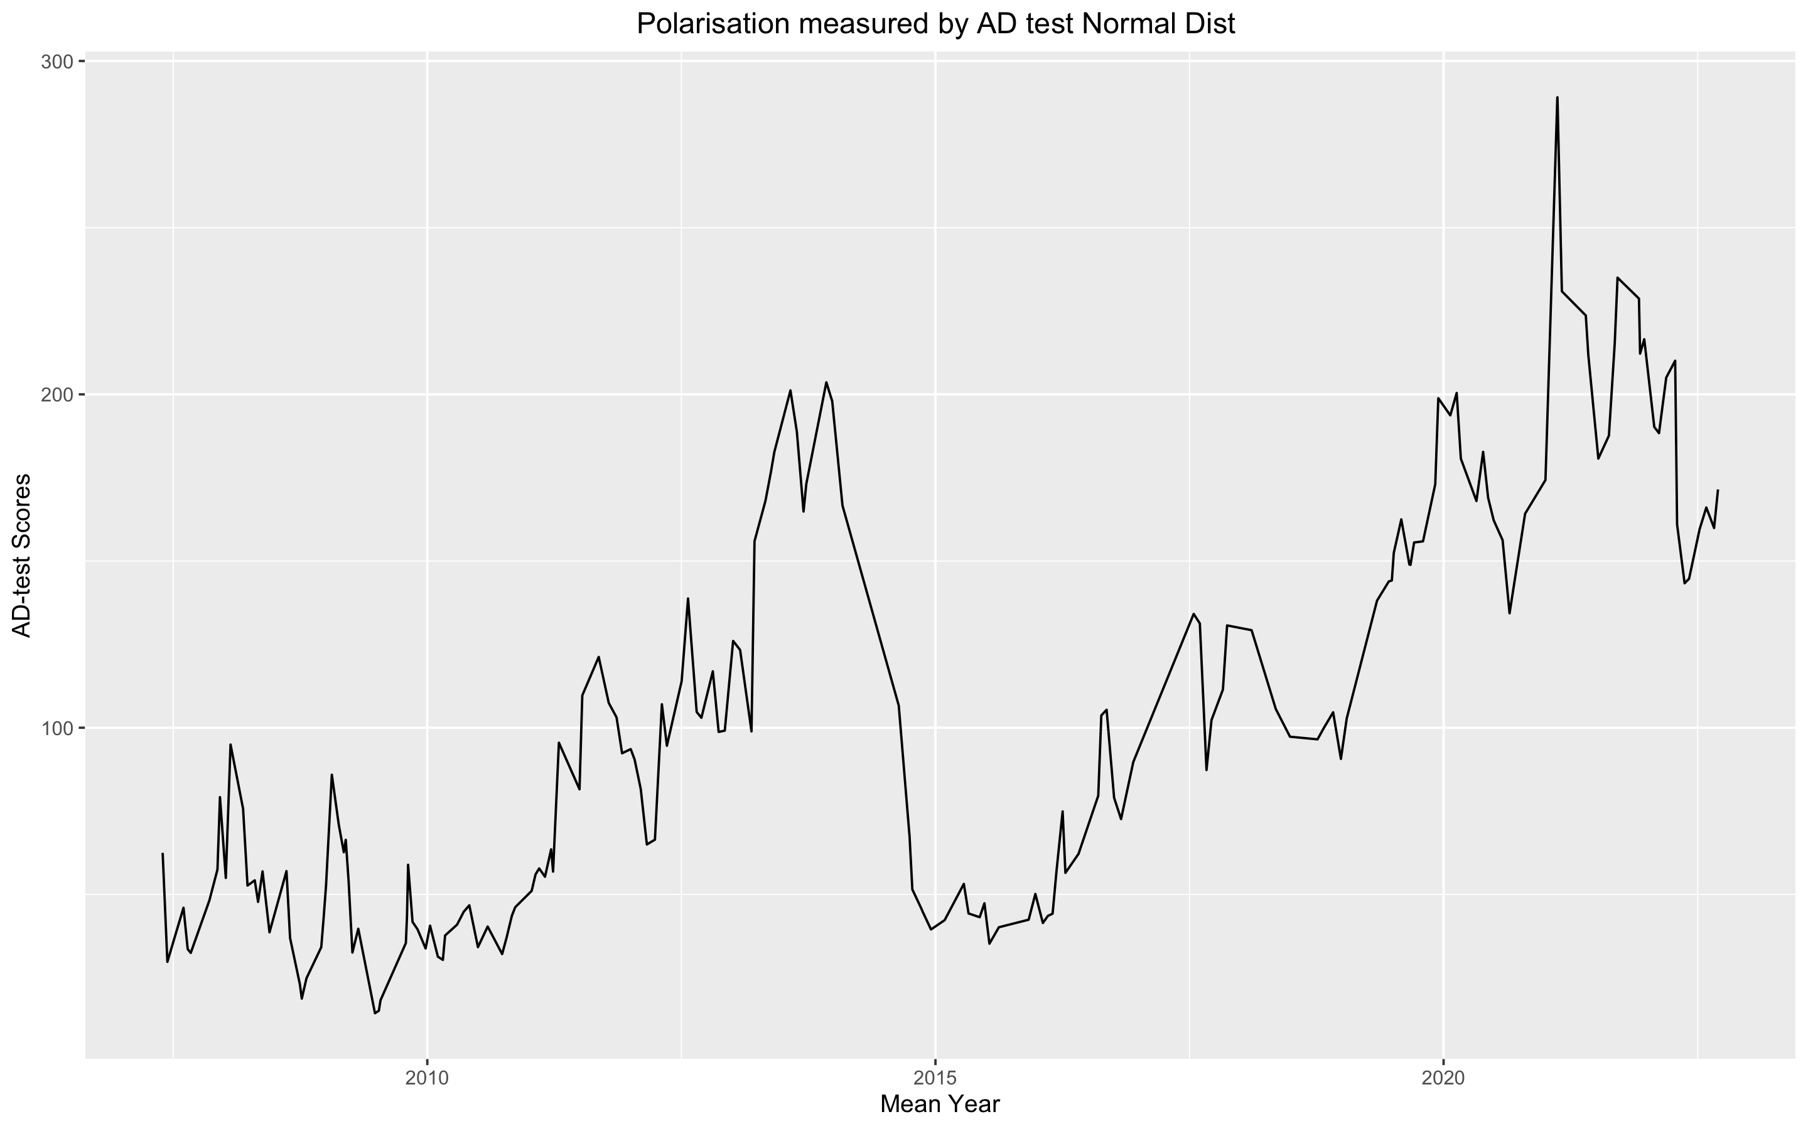
Trends

Slide 13
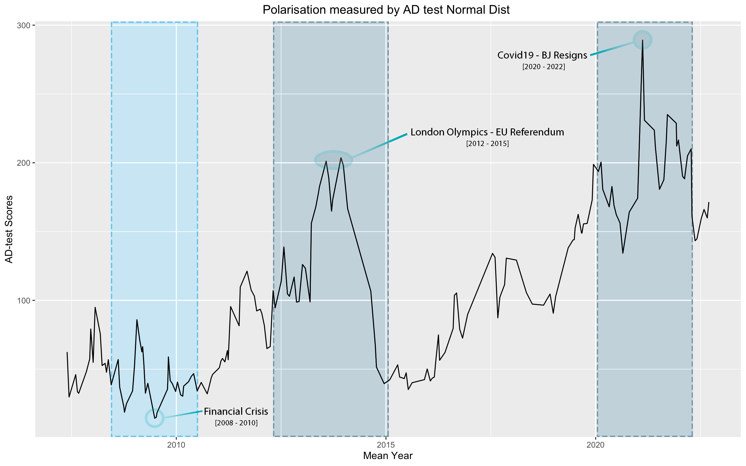
Trends

Slide 14
Data - Hansard
Methodology
Voting data pins down MPs opinion at a given time
The Hansard public record missing data between 2004 & 2006
The Parliment.data API contained 3,972 divisions in that time. [Division Title, Date, Number of Votes For, Number of Votes Against, MP names that Participated in the Division]
The API date and title was used to match divisions on the Parliament online website which counted 3,967 divisions in the same time frame
2,617 ‘Debate as Text’ .txt files were manually collected. These files contained between 100 & 10,000 words approximately

Slide 15
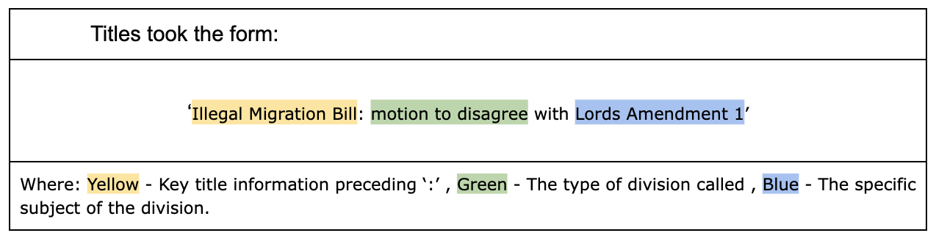
Data Engineering
Methodology

Slide 16
Clustering
Methodology
K-means clustering
Using the elbow method, I failed to identify ideal clusters for K, because the curve was smooth, gathering the majority of its effectiveness by 550 clusters. Obscure clusters were identified, putting ‘Adjournment Summer’ & ‘Holocaust Memorial’ in similar clusters. Little effort was given to optimising this technique, due to the poor initial clusters, although it effectively grouped like terms. The uniqueness of certain titles hindered k-means significantly
DBSCAN
An exciting method, successfully clustered groups when given a low minimum cluster value of 2, and epsilon 2.14. The problem with this method is that no matter how the parameters varied one cluster would explode in size before a significant enough number of total titles would become clustered. Of the 779 unique titles after pre-processing, 603 were left unclustered before cluster 6 expanded massively absorbing all other clusters. The maximum clusters that could be made was 32, with 603 titles unclustered
Hierarchical clustering
Forming clusters using a Jaccard distance matrix, and Ward.D2 method was the most successful strategy for clustering using traditional techniques. Using silhouette scores to identify peaks, the optimal amount of clusters was around 700 with a small secondary peak around 30. Formatted as a dendogram the clusters can be visualised but with 700 clusters, all information is lost
Initially an attempt was made to try and use the 30 large clusters as inputs to ChatGPT3.5 which would attempt to produce a cluster title for that group. This capability would be similar to early language models such as ‘Word2Vec’. The clusters suffered as they were at the same time not unique enough between clusters and two diverse within clusters. I believe the titles did not contain enough information alone to successfully complete this task using traditional NLP methods
LLM
At this stage ChatGPT-3.5 was used to identify 12 clusters, including 1 miscellaneous used to identify poorly defined categories. The model is trained with human interaction, which meant the clusters were relevant and interesting

Slide 17
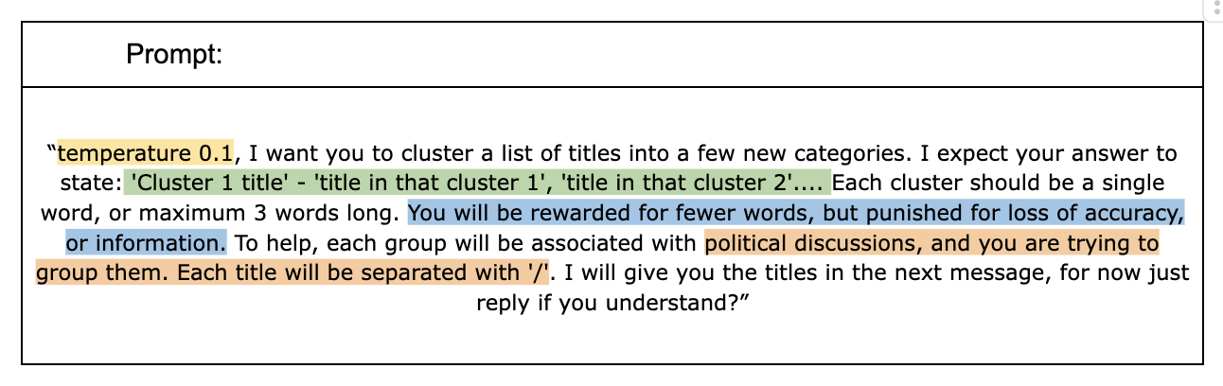
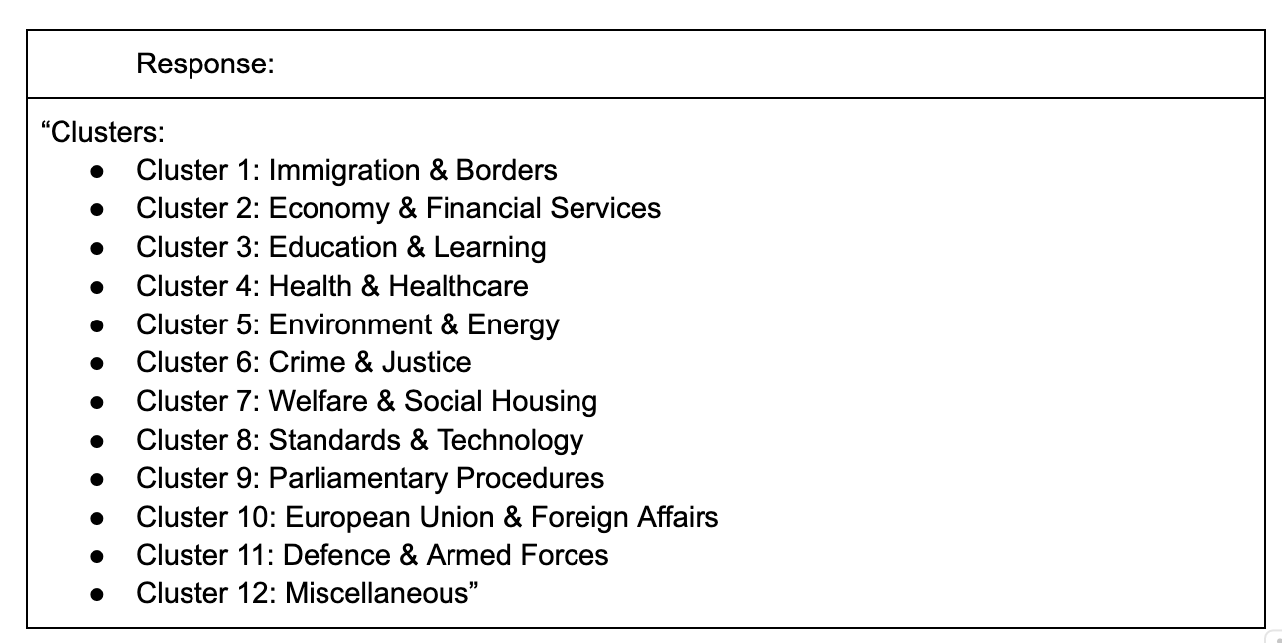
Clustering
Methodology

Slide 18
Classification – How does a division relate to a cluster?
Methodology
A division can be a vote for, or against a bill, an amendment to a bill, or a motion to disagree with an amendment to a bill. It takes experts to understand the complexity of any debate, before breaking down the logic behind each division call.
I propose that with very tight prompt engineering, a large language model could outperform individual experts, and take a fraction of the time. For each division we are looking for either a 1 or a -1 corresponding to the relationship between the division and its cluster. I.e.
Will, voting ‘For’ the division:
‘Illegal Migration Bill: motion to disagree with Lords Amendment 1’
Tighten or loosen immigration & border control? If it ‘tightens’ we can call this Sentiment: 1, and if it ‘loosens’ we can call this Sentiment: -1. That way when paired with a vote: Ayes: 1, Abstain: 0, Noes: -1, we can identify a politician's stance by taking the product of sentiment and vote.

Slide 19
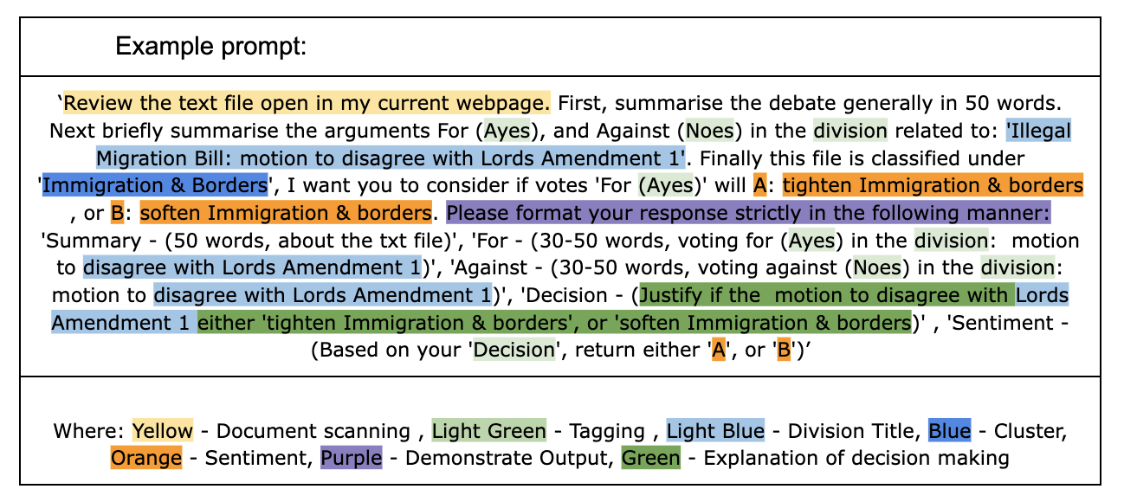
Classification
Methodology

Slide 20
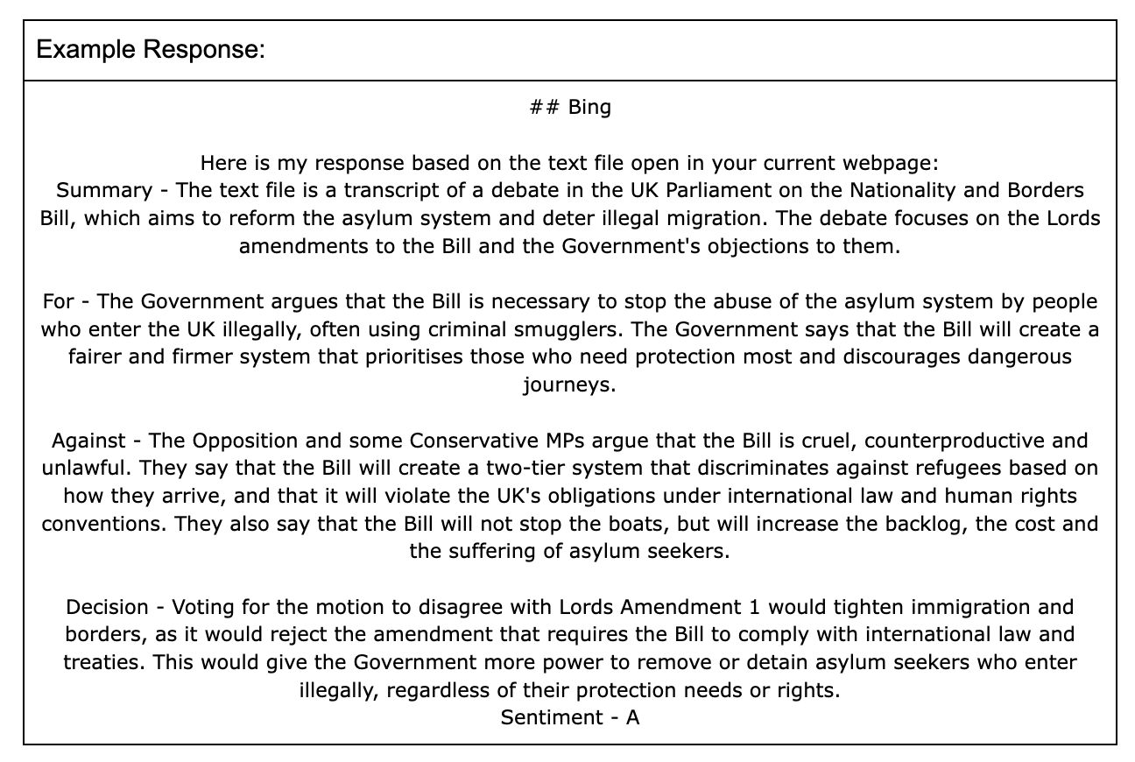
Classification
Methodology

Slide 21
Conclusion
Polarisation - We can safely conclude that during no period between 2006 and 2023 has the House of Commons been more polarised than it is during this present era.
Digital Democracy - I was extremely pleased with the expressiveness of the voter profiles, especially picking out key events in Boris Johnson's later career.
LLMs - I see massive similarity between the advantages of Neural Networks for image processing, and the Large Language models for NLP.

